Slide 1
Computer Networks
by
Surendra Kr.Keshari
Assistant Professor
KIET Group of Institutions

Slide 2
LAN Standards and FDDI

Slide 3
IEEE STANDARDS
In 1985, the Computer Society of the IEEE started a project, called Project 802, to set standards to enable intercommunication among equipment from a variety of manufacturers.
Project 802 is a way of specifying functions of the physical layer and the data link layer of major LAN protocols.

Slide 4

IEEE standard for LANs

Slide 5

STANDARD ETHERNET
The original Ethernet was created in 1976 at Xerox’s Palo Alto Research Center (PARC). Since then, it has gone through four generations.

Slide 6

802.3 MAC frame

Slide 7

Minimum and maximum lengths

Slide 8

Ethernet address in hexadecimal notation

Slide 9

Unicast and multicast addresses
The least significant bit of the first byte defines the type of address. If the bit is 0, the address is unicast; otherwise, it is multicast.
The broadcast destination address is a special case of the multicast address in which all bits are 1s.

Slide 10

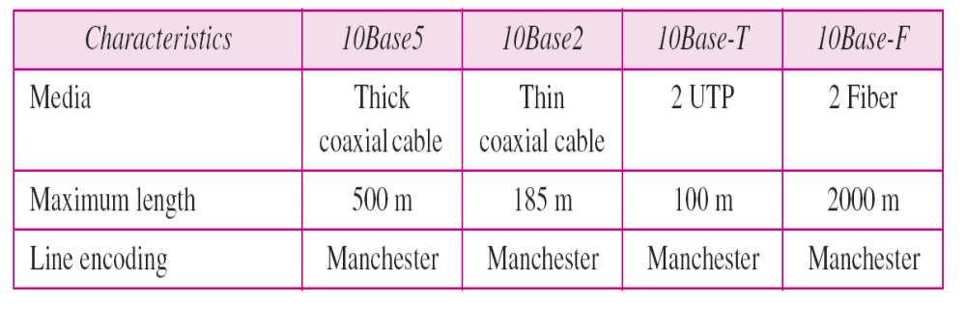
Categories of Standard Ethernet

Slide 11
FAST ETHERNET
Fast Ethernet was designed to compete with LAN protocols such as FDDI or Fiber Channel.
IEEE created Fast Ethernet under the name 802.3u.
Fast Ethernet is backward-compatible with Standard Ethernet, but it can transmit data 10 times faster at a rate of 100 Mbps.

Slide 12

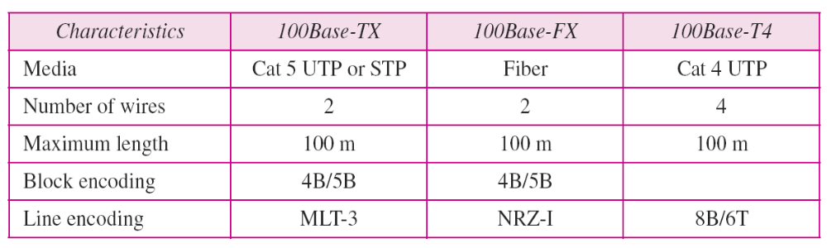
Fast Ethernet implementations

Slide 13
GIGABIT ETHERNET
The need for an even higher data rate resulted in the design of the Gigabit Ethernet protocol (1000 Mbps).
The IEEE committee calls the standard 802.3z.

Slide 14

Gigabit Ethernet implementations

Slide 15

Summary of Gigabit Ethernet implementations

Slide 16

Summary of Ten-Gigabit Ethernet implementations

Slide 17
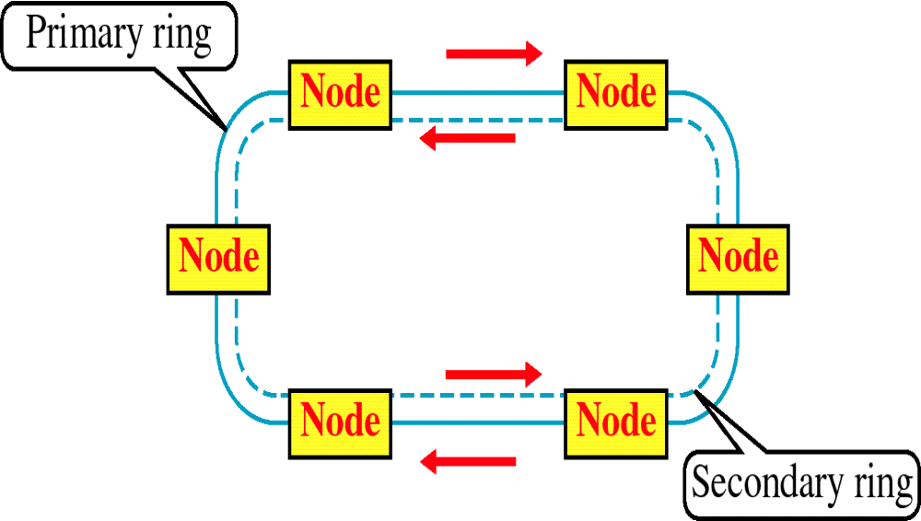
FIBER DISTRIBUTED DATA INTERFACE (FDDI)

Slide 18
FDDI
SHARED MEDIA NETWORK LIKE ETHERNET (IEEE 802.3) & IBM TOKEN RING (IEEE 802.5)
100 Mbps SPEED
RUNS ON OPTICAL FIBER
AMERICAN NATIONAL STANDARDS INSTITUTE (ANSI) STANDARD
TOKEN RING NETWORK LIKE IEEE 802.5
TOKEN: A SPECIAL SEQUENCE OF BITS
TOKEN CIRCULATES AROUND THE RING
A STATION REMOVES THE TOKEN FROM RING BEFORE TRANSMISSION
AFTER TRANSMISSION, THE STATION RETURNS THE TOKEN TO THE RING
COLLISIONS ARE PREVENTED AS THERE IS ONLY ONE TOKEN IN THE RING

Slide 19
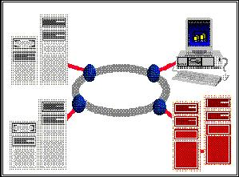
TOKEN RING NETWORK

Slide 20
FDDI LIMITATIONS
HIGH COST OF OPTICAL COMPONENTS REQUIRED FOR TRANSMISSION/RECEPTION OF SIGNALS (ESPECIALLY FOR SINGLE MODE FIBER NETWORKS)
MORE COMPLEX TO IMPLEMENT THAN EXISTING LOW SPEED LAN TECHNOLOGIES SUCH AS IEEE 802.3 AND IEEE 802.5

Slide 21
APPLICATIONS OF FDDI
OFFICE AUTOMATION AT THE DESKTOP
BACKBONES FOR FACTORY AUTOMATION
BACKEND DATA CENTER APPLICATIONS
CAMPUS LAN INTERCONNECTION
INTERCAMPUS BACKBONES OR METROPOLITAN AREA NETWORKS (MANs)
INTERCONNECTION OF PRIVATE BRANCH EXCHANGES (PBXS)
WORKGROUP AND DEPARTMENTAL LANS
INTEGRATED TRANSPORT FOR MULTIMEDIA APPLICATIONS

Slide 22
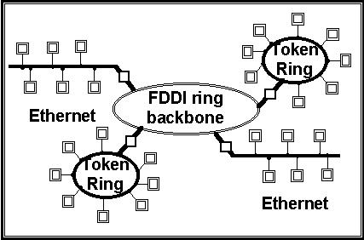
A FDDI BACKBONE NETWORK EXAMPLE

Slide 23
References
  Behrouz Forouzan, “Data Communication and Networking”, McGraw Hill
  Andrew Tanenbaum “Computer Networks”, Prentice Hall.
  William Stallings, “Data and Computer Communication”, Pearson.
  Kurose and Ross, “Computer Networking- A Top-Down Approach”, Pearson.
  Peterson and Davie, “Computer Networks: A Systems Approach”, Morgan Kaufmann
  W. A. Shay, “Understanding Communications and Networks”, Cengage Learning.
  D. Comer, “Computer Networks and Internets”, Pearson.
  Behrouz Forouzan, “TCP/IP Protocol Suite”, McGraw Hill.

Slide 24
Thank
You

